Slide 1

“agonism”: design-led inquiries towards transforming cultural venues
New Origins: Designing Countercultural Heritage
Dr Violeta Tsenova, StoryLab Research Institute, ARU
25th June 2024
Notes:
Say what countercultural heritage is here – a trope designed to amplify the message that there are different ways of designing heritage.
What is “transformation” – not a complete overrun but thinking about the processes (of participation) that facilitate diverse heritages and that re-evaluate power relationships (who makes the decisions, why)
High-lever overview of what agonism is
The question this presentation seeks to explore (but probably not answer) is: What methods might we use to facilitate ongoing acts of divergent heritage making? What methods might we appropriate in our processes? The answer I speculate with is whether we could use citizen assemblies

Slide 2
structure
The issue with museums / cultural venues
  The issue as manifested in 2 projects
Agonism
  What is it? How has it been used?
Implementing agonism in designing for countercultural heritage
  Citizen Assemblies as a method for divergent heritage-making
Limitations

Slide 3
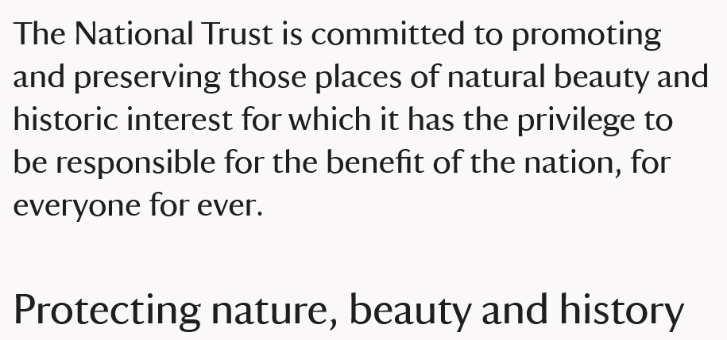
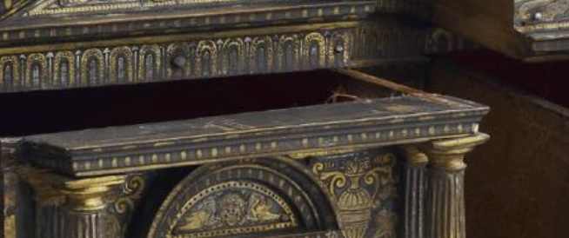

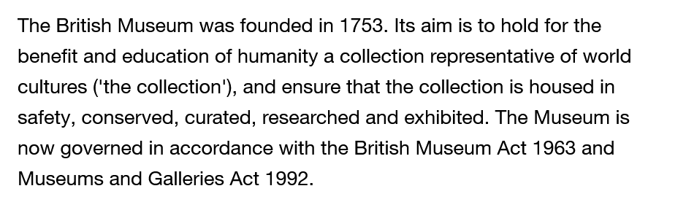
The issue

Slide 4
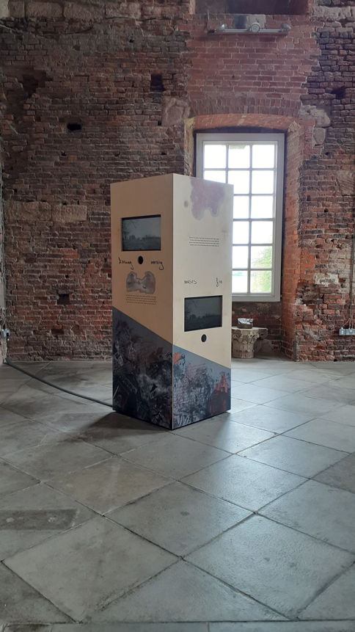
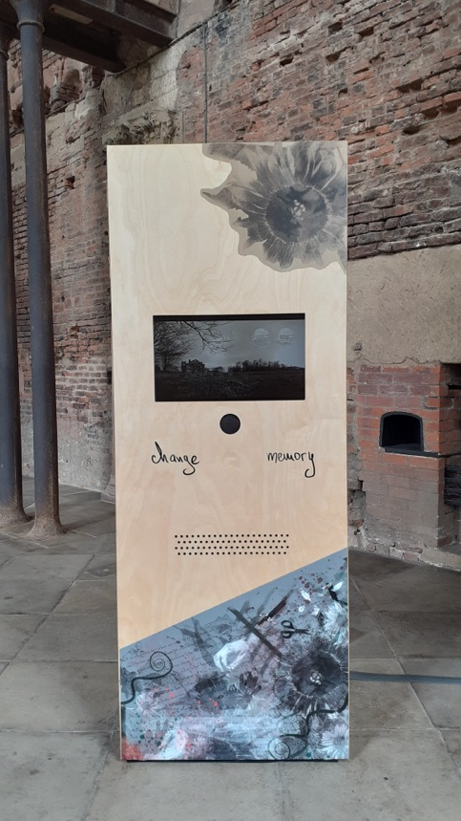
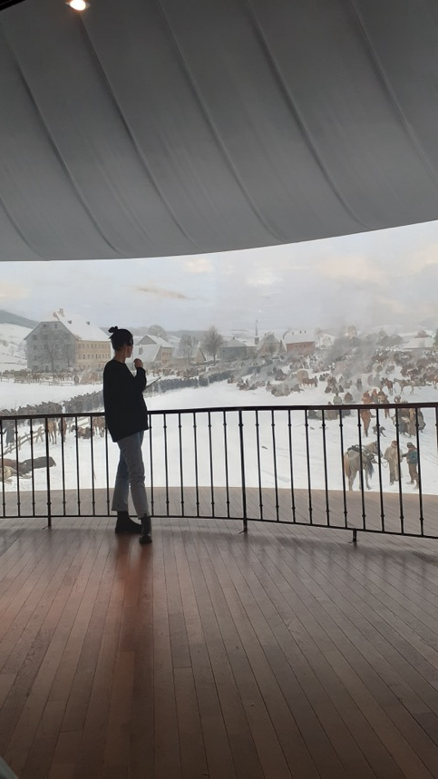
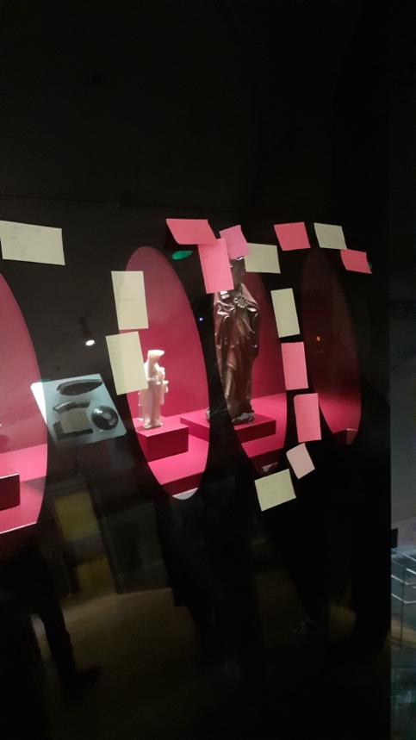
“Designing with Genius Loci”
Seaton Delaval Hall, 2017-2021
The Participatory Public History Lab
The House of European History, 2022-2024

Slide 5
Participation as a political term
“Participation is a good thing, but we [museums] fail to do it right. So, the solution to failed participatory projects is to do more participation but better.”
Helen Graham’s criticism of museums’ approach to participation

Slide 6
questions
What methods might we use to activate participation as a political term?
What frameworks might help us design these methods?

Slide 7

AGONISM
Social and political theory
(Chantal Mouffe and Ernesto Laclau; William E. Connoly; Hannah Arendt)
ἀγών = "struggle"
Notes:
emancipatory potential of political contestation and of the disruption of settled practice
Keeping in mind that politics is neither pure consensus or pure contestation
Agonism is based on contestation, but in a political space where the discourse is one of respect, rather than violence. Unlike toleration, agonistic respect actively engages adversaries in political contests over meaning and power.

Slide 8
agonism
 | Aggregative Model | Liberal Model | Agonistic Model
Conflict vs. Consensus | Seeks consensus through majority rule | Aims for consensus while protecting individual rights | Embraces and channels conflict as essential for democracy
Role of Debate | Limited debate; focuses on voting outcomes | Encourages debate within a rational consensus framework | Promotes ongoing, open-ended debates where conflict is encouraged
View on Pluralism | Aggregates diverse preferences into a majority decision | Accommodates diversity but seeks harmonisation | Values and expresses diverse, often conflicting perspectives
Democratic Engagement | Engagement primarily through voting | Engagement through voting, legal protections, and deliberation | Engagement through active, contentious participation and debate
“oligarchic” democracy (Claudia Chwalisz, Amelie Klein and Vera Saccheti from DemocracyNext )
“agonistic moments” – recognising ourselves as political subjects
(Marco de Waard)
activating emotions
Notes:
Thus, for agonistic pluralists, if reason alone cannot yield a legitimate uniform consensus, and power imbalances can never truly be removed from the public sphere, then one must accept the inevitability of conflict in the political realm.
I don’t think it will work as a democratic model but the thinking is interesting.

Slide 9
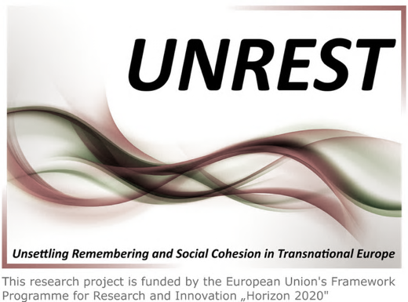
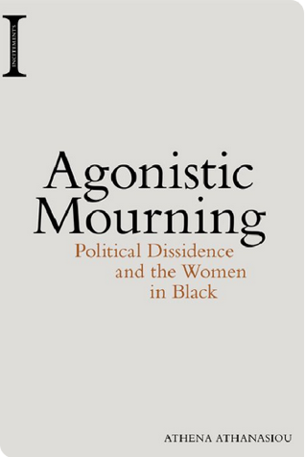

Uses of agonism
Memory Studies
Agonistic Memory (Cento Bull and Hansen, 2016)
Resonances in Public History
Design
Adversarial Design (DiSalvo, 2012)
Agonistic Participatory Design (Björgvinsson et al., 2012)
“Chains of Equivalence” (Geppert and Forlano, 2022)

Slide 10
Reality check
Agonism presupposes shared values of democracy and equity
Too much fragmentation is counter-effective
Deliberation in direct democracy vs deliberation in liberal democracy
More used as a social theory and inspiration
Notes:
We get into circling with the same arguments and the same ways of doing things (contradictions which I find in myself as I think through this)
Reactivating participation in forms of public formation

Slide 11
Reality check 2
Word-washing participation
How might we structure processes of transformation
Spaces to contest power relations
Citizen Assemblies
(e.g., exhibitions)
Museums retain power
Activate emotions
Agonistic Lens
Museums as liberal institutions
Realise political subjectivity

Slide 12
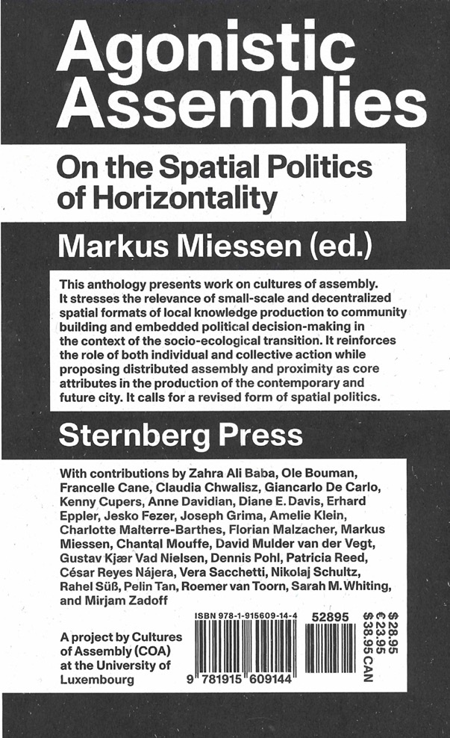
Citizen assemblies

Slide 13
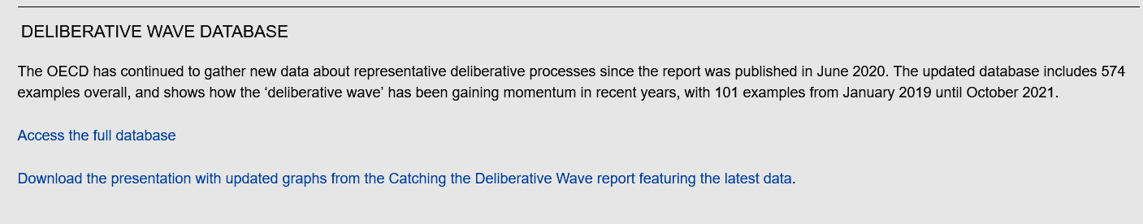
Belgium’s The Ostbelgien Model
Paris citizens assembly
“A Citizens’ Assembly is a representative group of citizens who are selected at random from the population to learn about, deliberate upon, and make recommendations in relation to a particular issue or set of issues. […] The aim is to secure a group of people who are broadly representative of the electorate across characteristics such as their gender, ethnicity, social class, and the area where they live.”
CitizenAssembly.co.uk
Notes:
As governance systems are failing to address some of society’s most pressing issues and trust between citizens and government is faltering, Citizens’ Assemblies embody the potential of democratic renewal. They create the democratic spaces for everyday people to grapple with the complexity of policy issues, listen to one another, and find common ground.

Slide 14
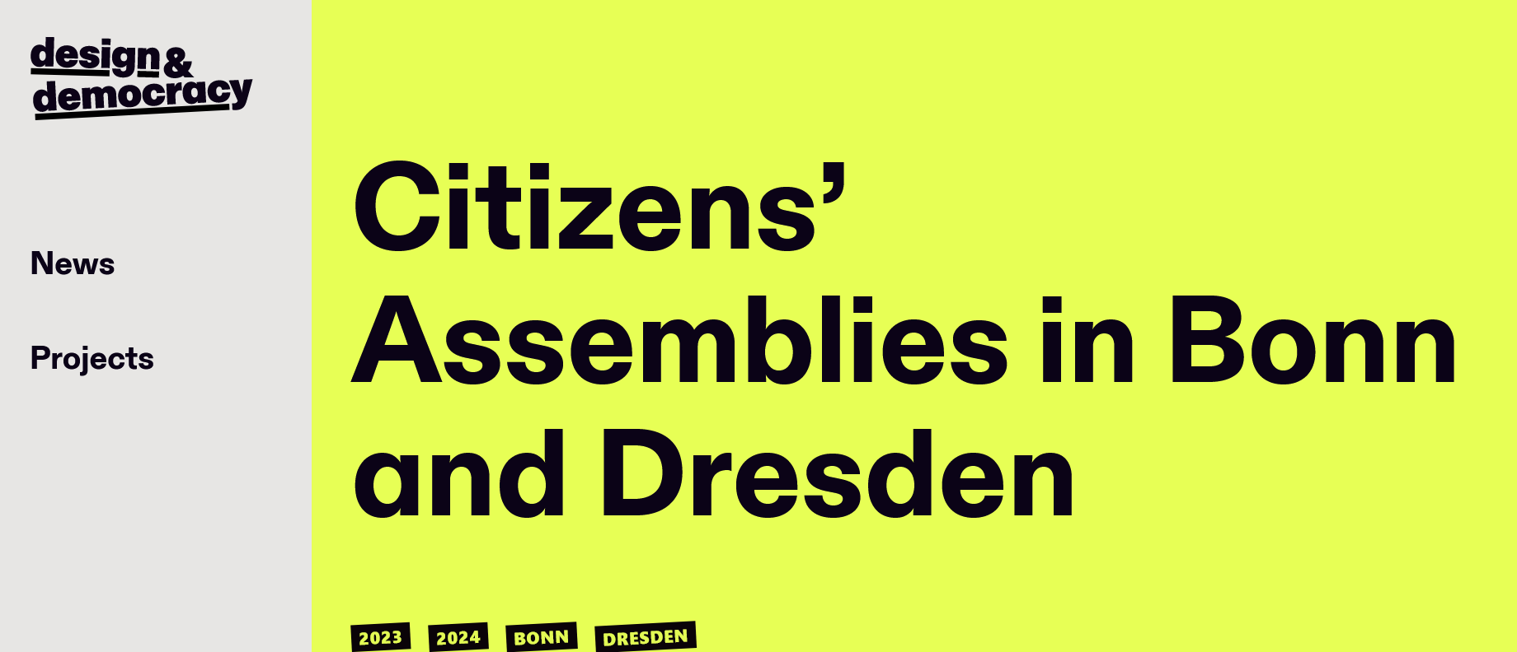

All In! Redesigning Democracy

Slide 15
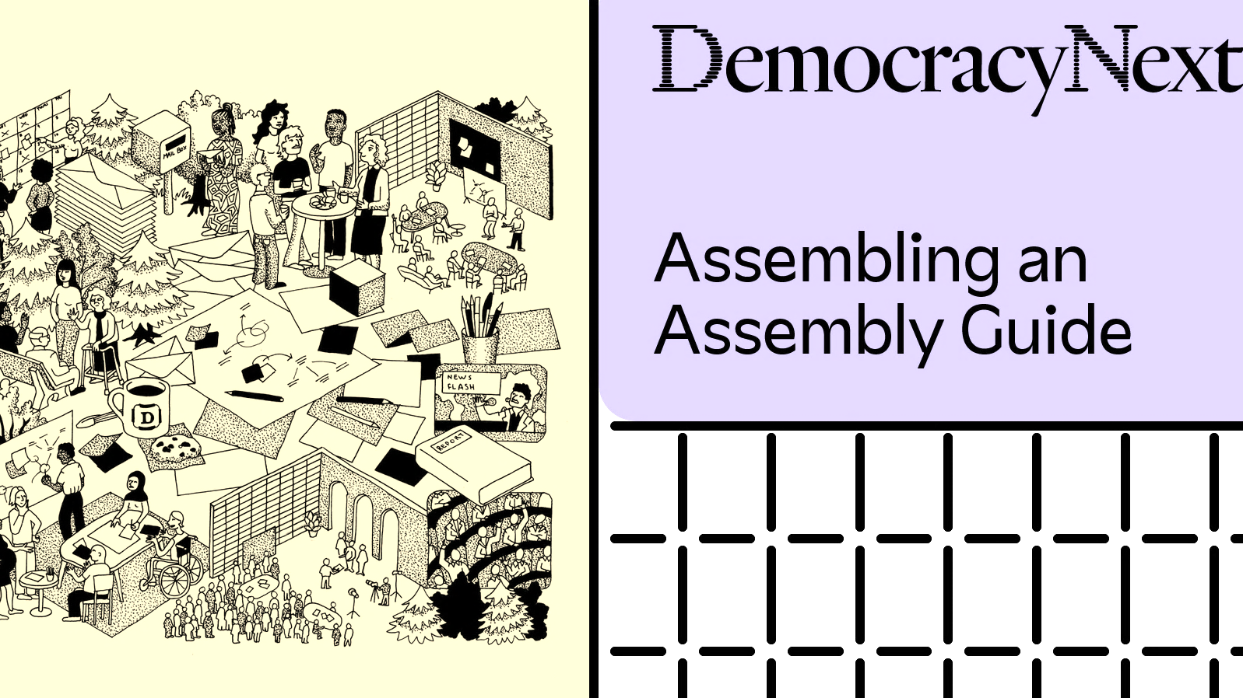
A speculation
picture credit: assemblyguide.demnext.org
Notes:
How can cultural venues become spaces for the discussion of other things?

Slide 16
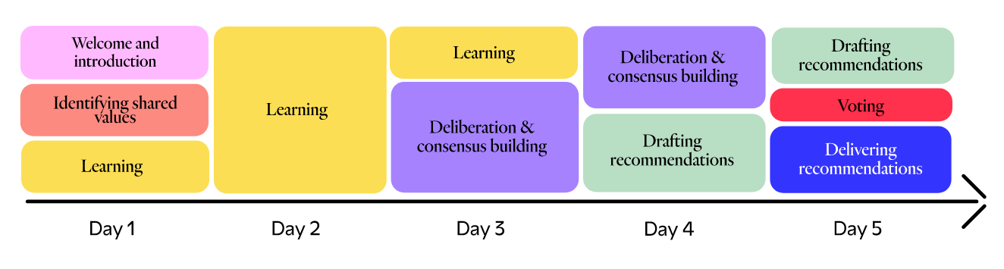
1. Pre-Assembly
- the question
- selection (lottery and stratification)
- information base (experts and stakeholders, information kit, additional expertise)
2. During the Assembly
- building trust
- facilitators of citizen deliberation
3. After the Assembly
- a formal public response to the recommendations
- monitoring the implementation of selected recommendations
- formal updates
assemblyguide.demnext.org
Notes:
“Deliberation involves dialogue and debate, but also implies inquiry, careful listening, consideration of a range of different arguments and opinions in a respectful way. It requires accurate and relevant information and adequate time, so that those deliberating can get to the core of the issue. It creates the conditions for people to grapple with complexity, tap into collective intelligence, and find common ground.”
“Find the balance between a framing that is too broad to result in useful recommendations and too narrow to miss a chance to generate new and helpful ideas”
Possible question: How might we support citizen curation of exhibitions? / How should exhibitions be curated to showcase multiple perspectives? How might cultural institutions work to exhibit conflict by engaging with representatives from different sides?
I think it has to be about structuring participation
Community concerned -> is it those living in vicinity? Is it the entire audience?
Write through how this might work
Allows us to see wider contestations rather than face-to-face ones on small-scale participatory projects

Slide 17
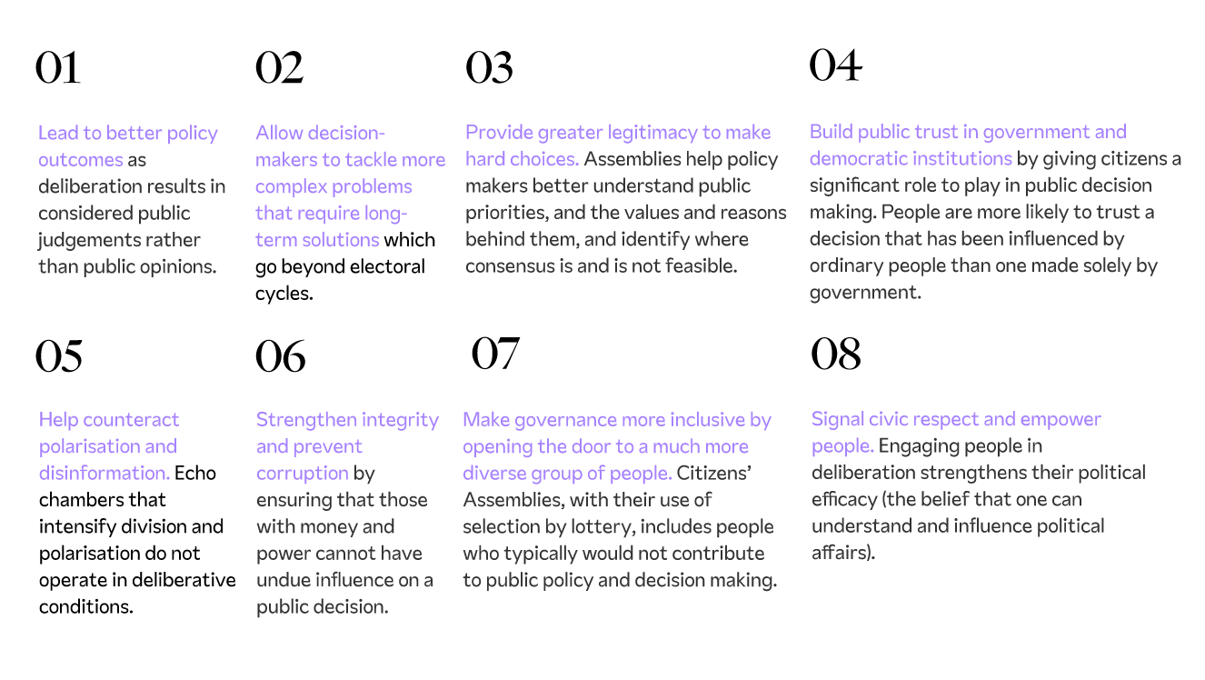
assemblyguide.demnext.org
Notes:
Inherent to the idea is also rotation – that we take turns representing and being represented, since we can’t all be involved in all decisions all the time.
The decision-making authority should publicly commit.

Slide 18
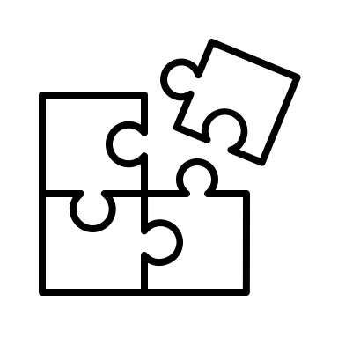
limitations
Agonism is used “therapeutically” -> I am also cherry picking
Maybe other theories are more helpful -> direct democracy and deliberation
Assemblies – more word-washing? + not appropriate for every context
We need to be on the same page about change and why it is necessary
Agonistic thinking as a more helpful lens
  Forming publics around a shared agenda
  Can assemblies facilitate emotion? -> a whole area to design for

Slide 19

Thank you!
Dr Violeta Tsenova
violeta.tsenova@aru.ac.uk
@ViTsenova

